Slide 1
Social Media and The Law: Reloaded
Paul Scholey
Senior Partner
Head of Employment Rights
Morrish Solicitors LLP
November 2015

Slide 2
Agenda
New statistics
New cases
Any new conclusions?

Slide 3
A Question of Scale
Facebook 1.3 billion March 14 1.49 billion MAUs (Aug15)
Instagram 400m MAUs (Aug 15)
But QQ is catching up (829m, Jan 15)

Slide 4
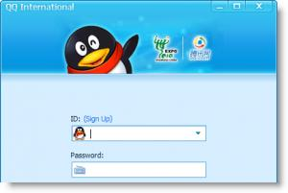
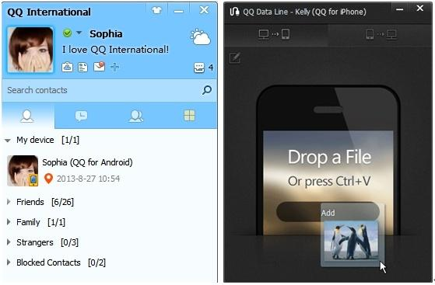
A Question of Scale

Slide 5
Who, What & When?
25 to 34, at 29.7% of users, is the most common age demographic
Facebook users are 76% female and 66% male
4.5 billion likes generated daily as of May 2013
1 – 3pm midweek is top posting time

Slide 6
General Principles
Employment Rights Act 1996 Section 98(4)
A potentially fair reason +
Fairness - “in accordance with equity and the substantial merits of the case”
The “band of reasonable responses”
The importance of fair procedures

Slide 7
ACAS Guidance
Contrast serious reputational attacks and “letting off steam”
Nature of Job & Seniority
Seriousness of misconduct
Nature of organisation
Terms of any policy
Disclosure of confidences
Risk of reputational damage
Impact on job
Mitigating factors

Slide 8
New cases
Williams v Leeds Utd FC
Employee under notice of redundancy
Employer trawls email account
Dismissal on basis of emails 5 years old?

Slide 9
Texts
Mason v Huddersfield Giants
Text sent by 3rd party
Wrongful Dismissal?
Cf. unfair dismissal?

Slide 10
Revenge Porn
Anecdotal evidence
Secondary School Teacher
Victim of revenge attack - photos posted to FB
School approached by parents – threat of dismissal
Some other substantial reason?

Slide 11
Texts & Consistency
MBNA v Jones (30.10.15)
Work function at Chester Races
A punch followed by threatening texts
Dismissal vs FWW?

Slide 12
Facebook
British Waterways v Smith (Aug 15)
Remarks made about BWB on FB lead to internal mediation
Manager digs out posts 2+ y/o including remarks about drinking on standby
Permissible to rely on old (known) posts to dismiss?

Slide 13
Facebook
Trasler v B&Q
Facebook criticisms of the employer
Threatening? Gross misconduct?
Contribution?
Contrast with:

Slide 14
Facebook
Weeks v Everything Everywhere
Facebook again
Work, the Circles of Hell, and reputational damage
Threats towards fellow colleague who tipped off the employer

Slide 15
Reputational Risk: factors
Consider:
How serious was the disclosure?
How many people saw it?
Who saw it?
Were there complaints?
Was the employer’s identity clear?
Was confidential information disclosed?

Slide 16
Facebook – devil in the detail
Blue v FSA
Joining in on others’ FB exchange regarding hitting a colleague:
“Aye right, i wish.”
Whether outside the band of reasonable responses

Slide 17
Summarising the approach?
See e.g. Lake v Amey (2015)
A reluctance to set special principles in social media cases
But the authorities are becoming clearer as to the sort of factors being taken into account
See the Lake summary on IER’s website

Slide 18
End
Social Media and the law will return…

